Slide 1
PA Court Ordered Remedial Plan
Analysis by Jonathan R. Cervas and Bernard Grofman

Slide 2
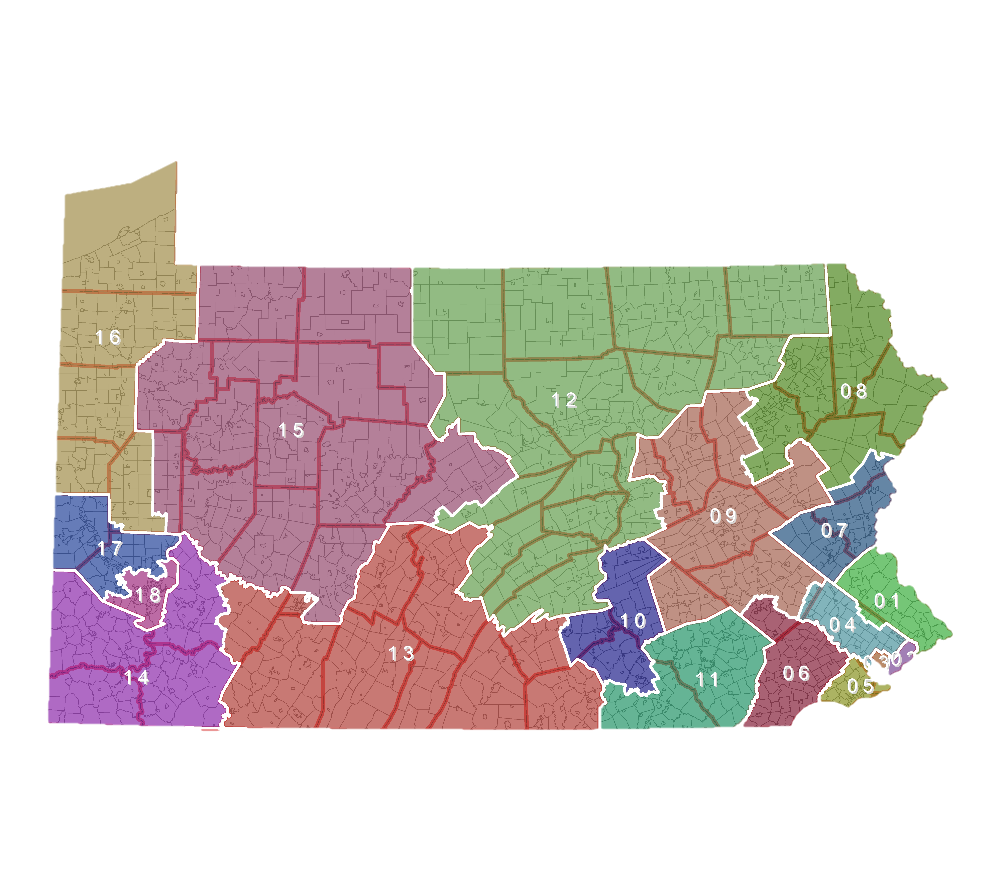

Slide 3
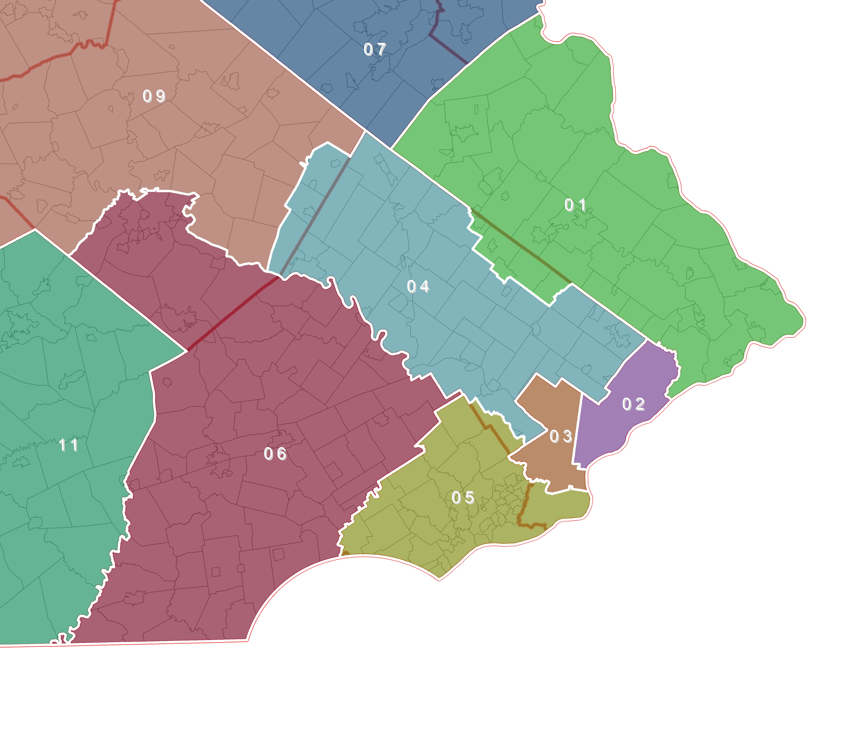
Philadelphia

Slide 4
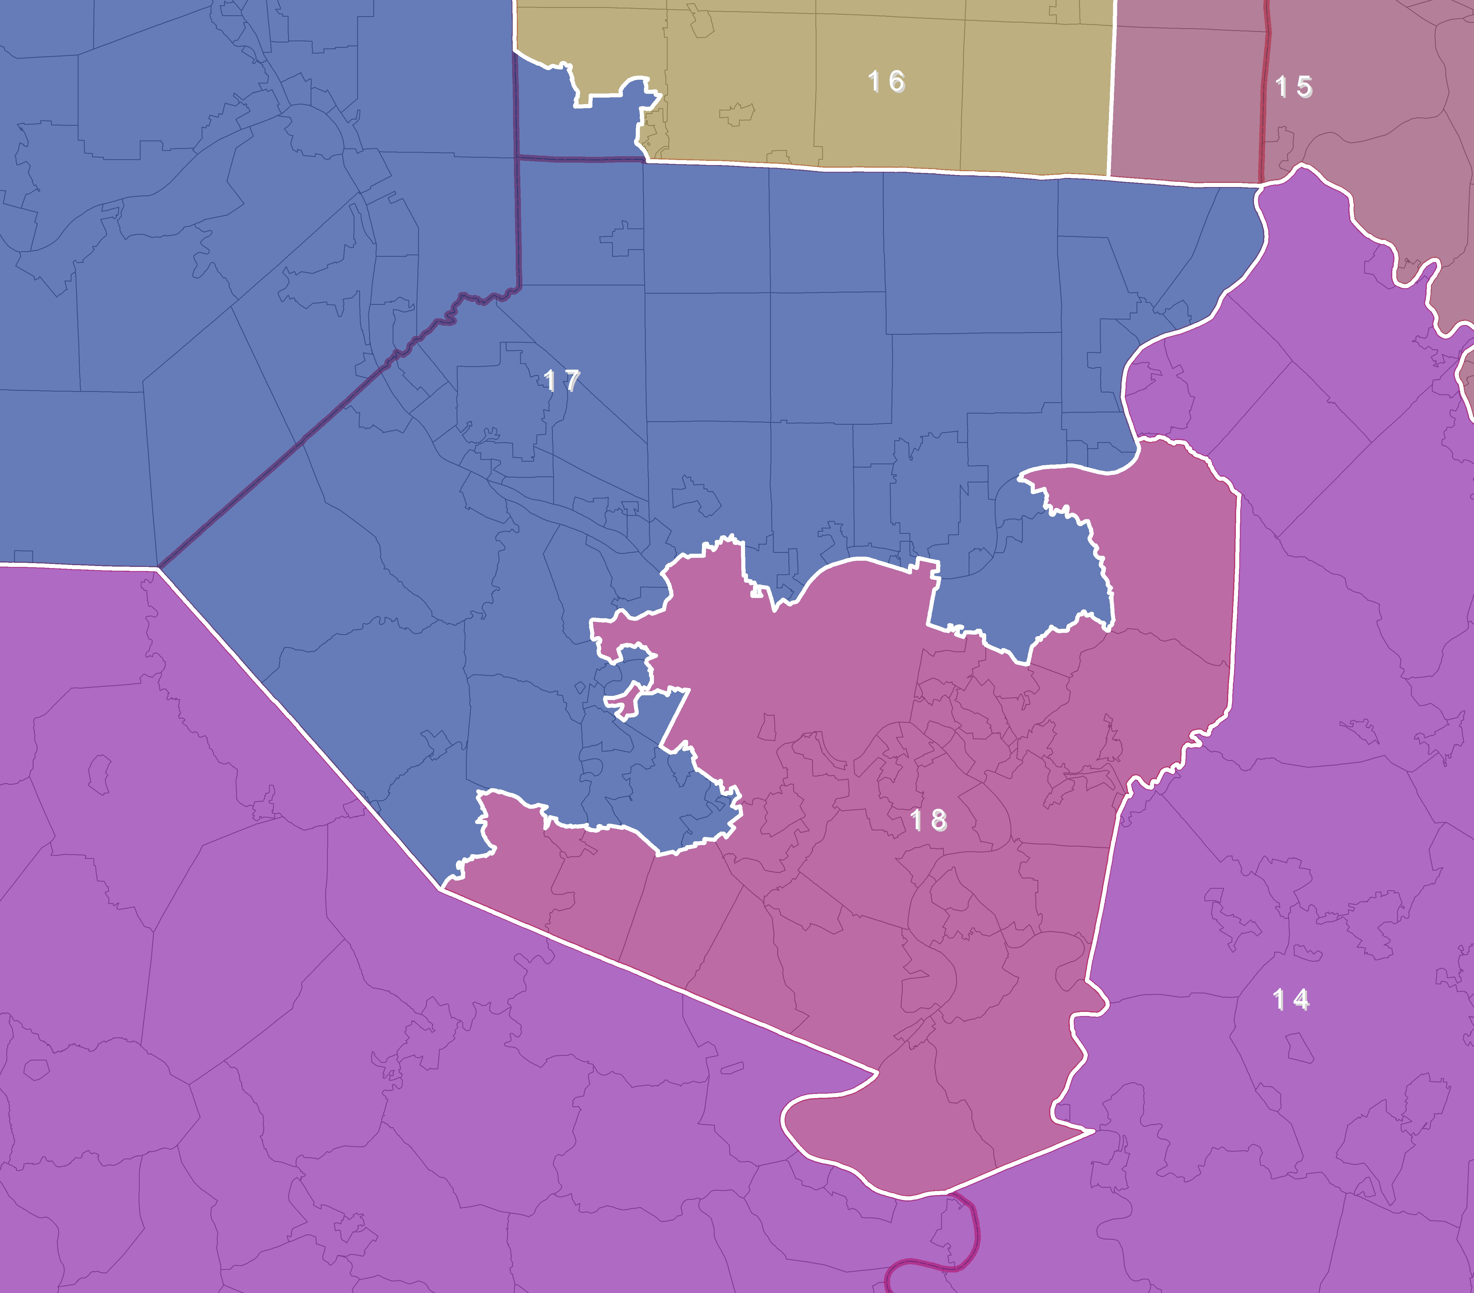
Pittsburgh

Slide 5
District Breakdowns
5 Strong Democrat
7 Strong Republican
6 Swing Districts
(2 Lean Democrat, 4 Lean Republican)
* PVI calculated by Aaron Bycoffe, Five Thirty Eight
Mean Compactness
Reock | Schwartzberg | Polsby-Popper | Population Polygon | Min Convex Poly
0.46 | 1.67 | 0.33 | 0.74 | 0.79

Slide 6
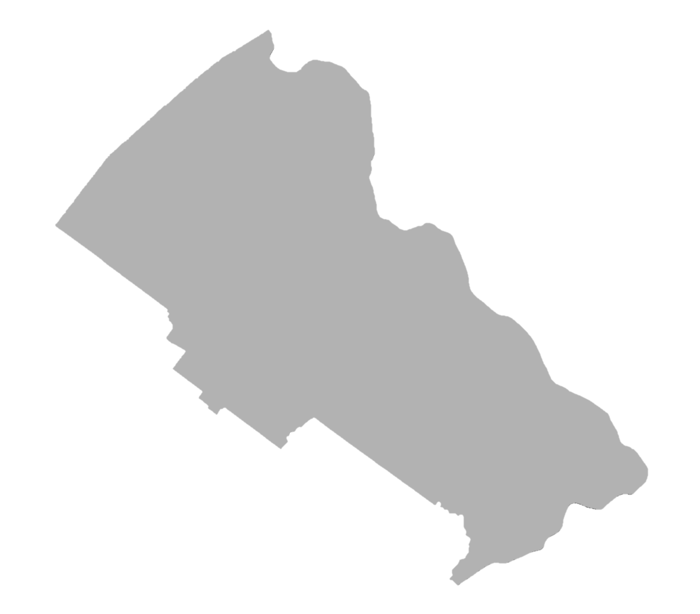
District 1 Lean Republican
PVI
R+0.55
Counties:
Bucks
Montgomery (Part)
Reock | Schwartzberg | Polsby-Popper | Population Polygon | Min Convex Poly
0.43 | 1.43 | 0.46 | 0.78 | 0.83

Slide 7
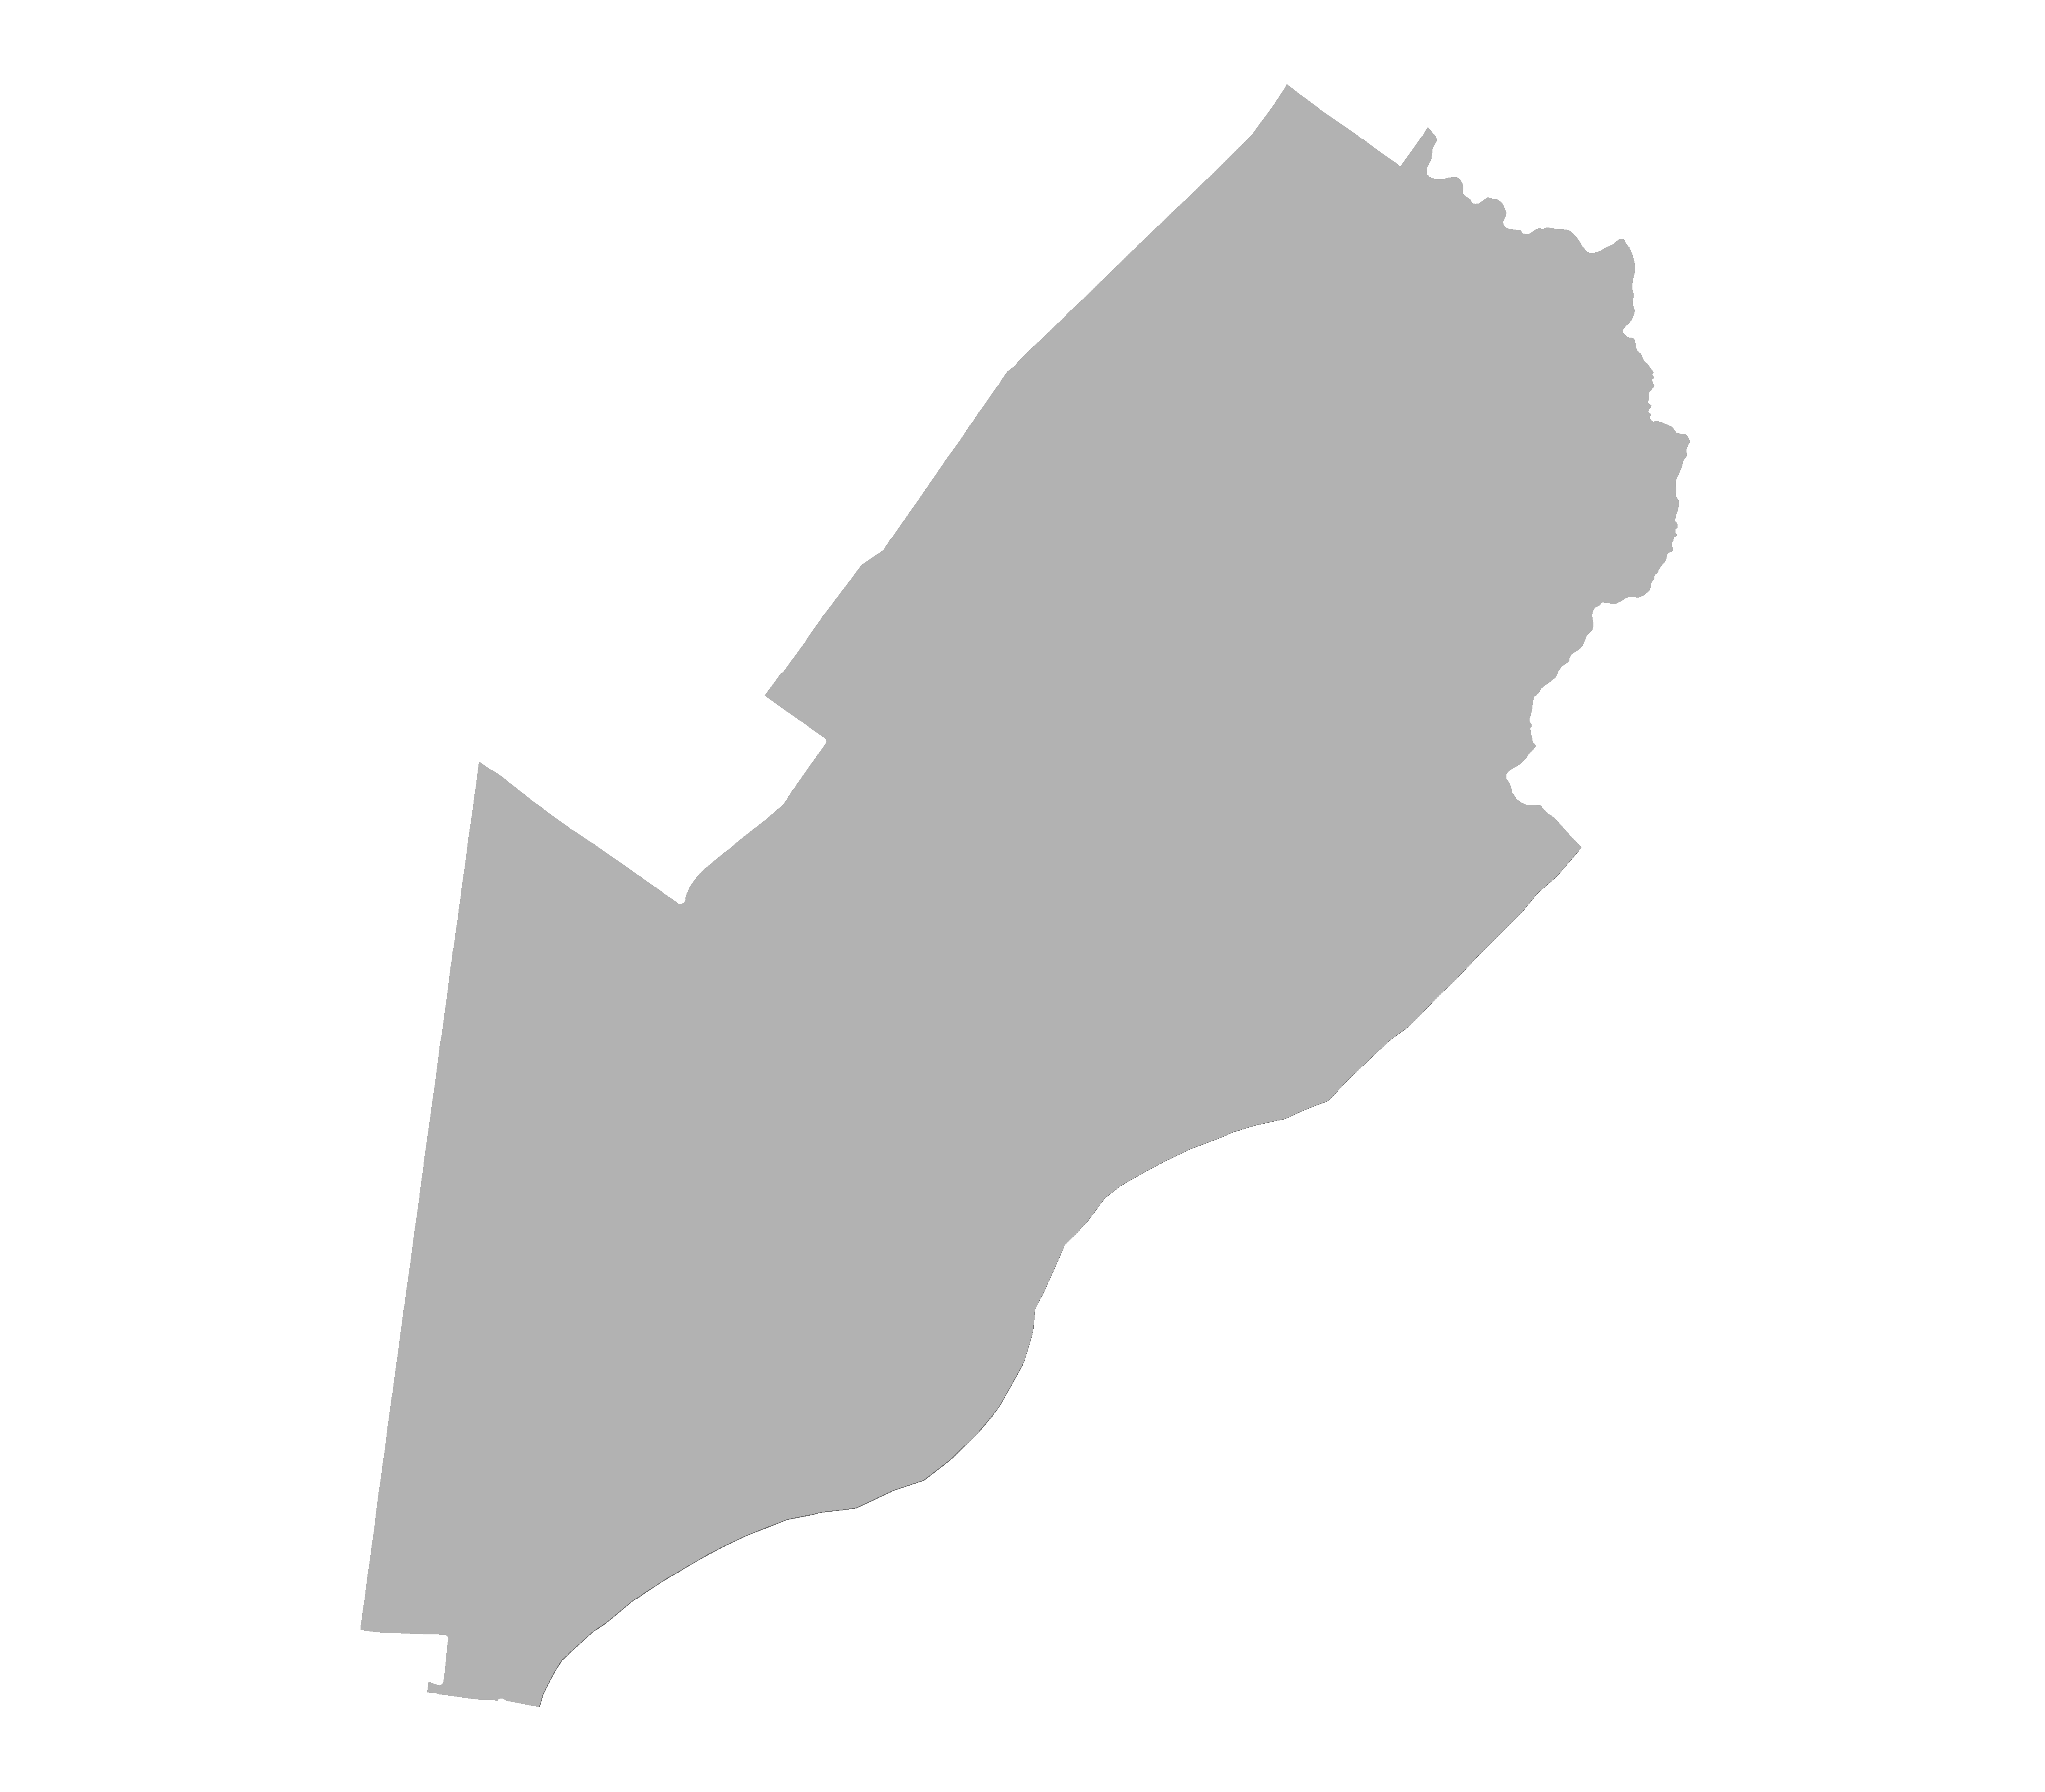
District 2 Strong Democrat
PVI
D+24.75
Minority-Coalition (African-American, Asian, and Hispanic)
Counties:
Philadelphia (part)
Reock | Schwartzberg | Polsby-Popper | Population Polygon | Min Convex Poly
0.37 | 1.42 | 0.47 | 0.96 | 0.86

Slide 8
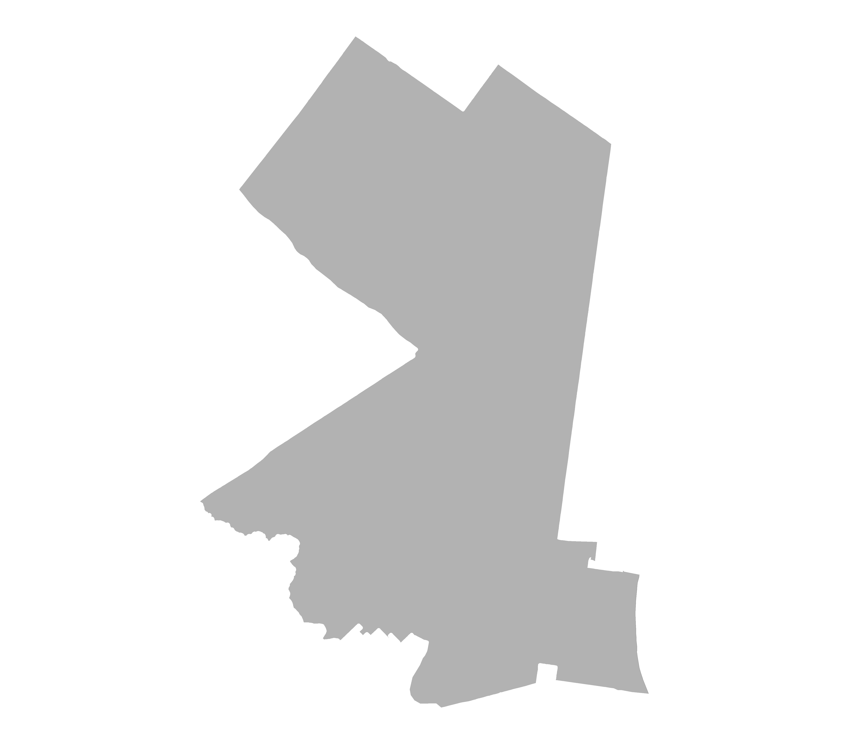
District 3 Strong Democrat
PVI
D+41.05
Majority-Minority (African American)
Counties:
Philadelphia (part)
Reock | Schwartzberg | Polsby-Popper | Population Polygon | Min Convex Poly
0.43 | 1.63 | 0.36 | 0.80 | 0.74

Slide 9
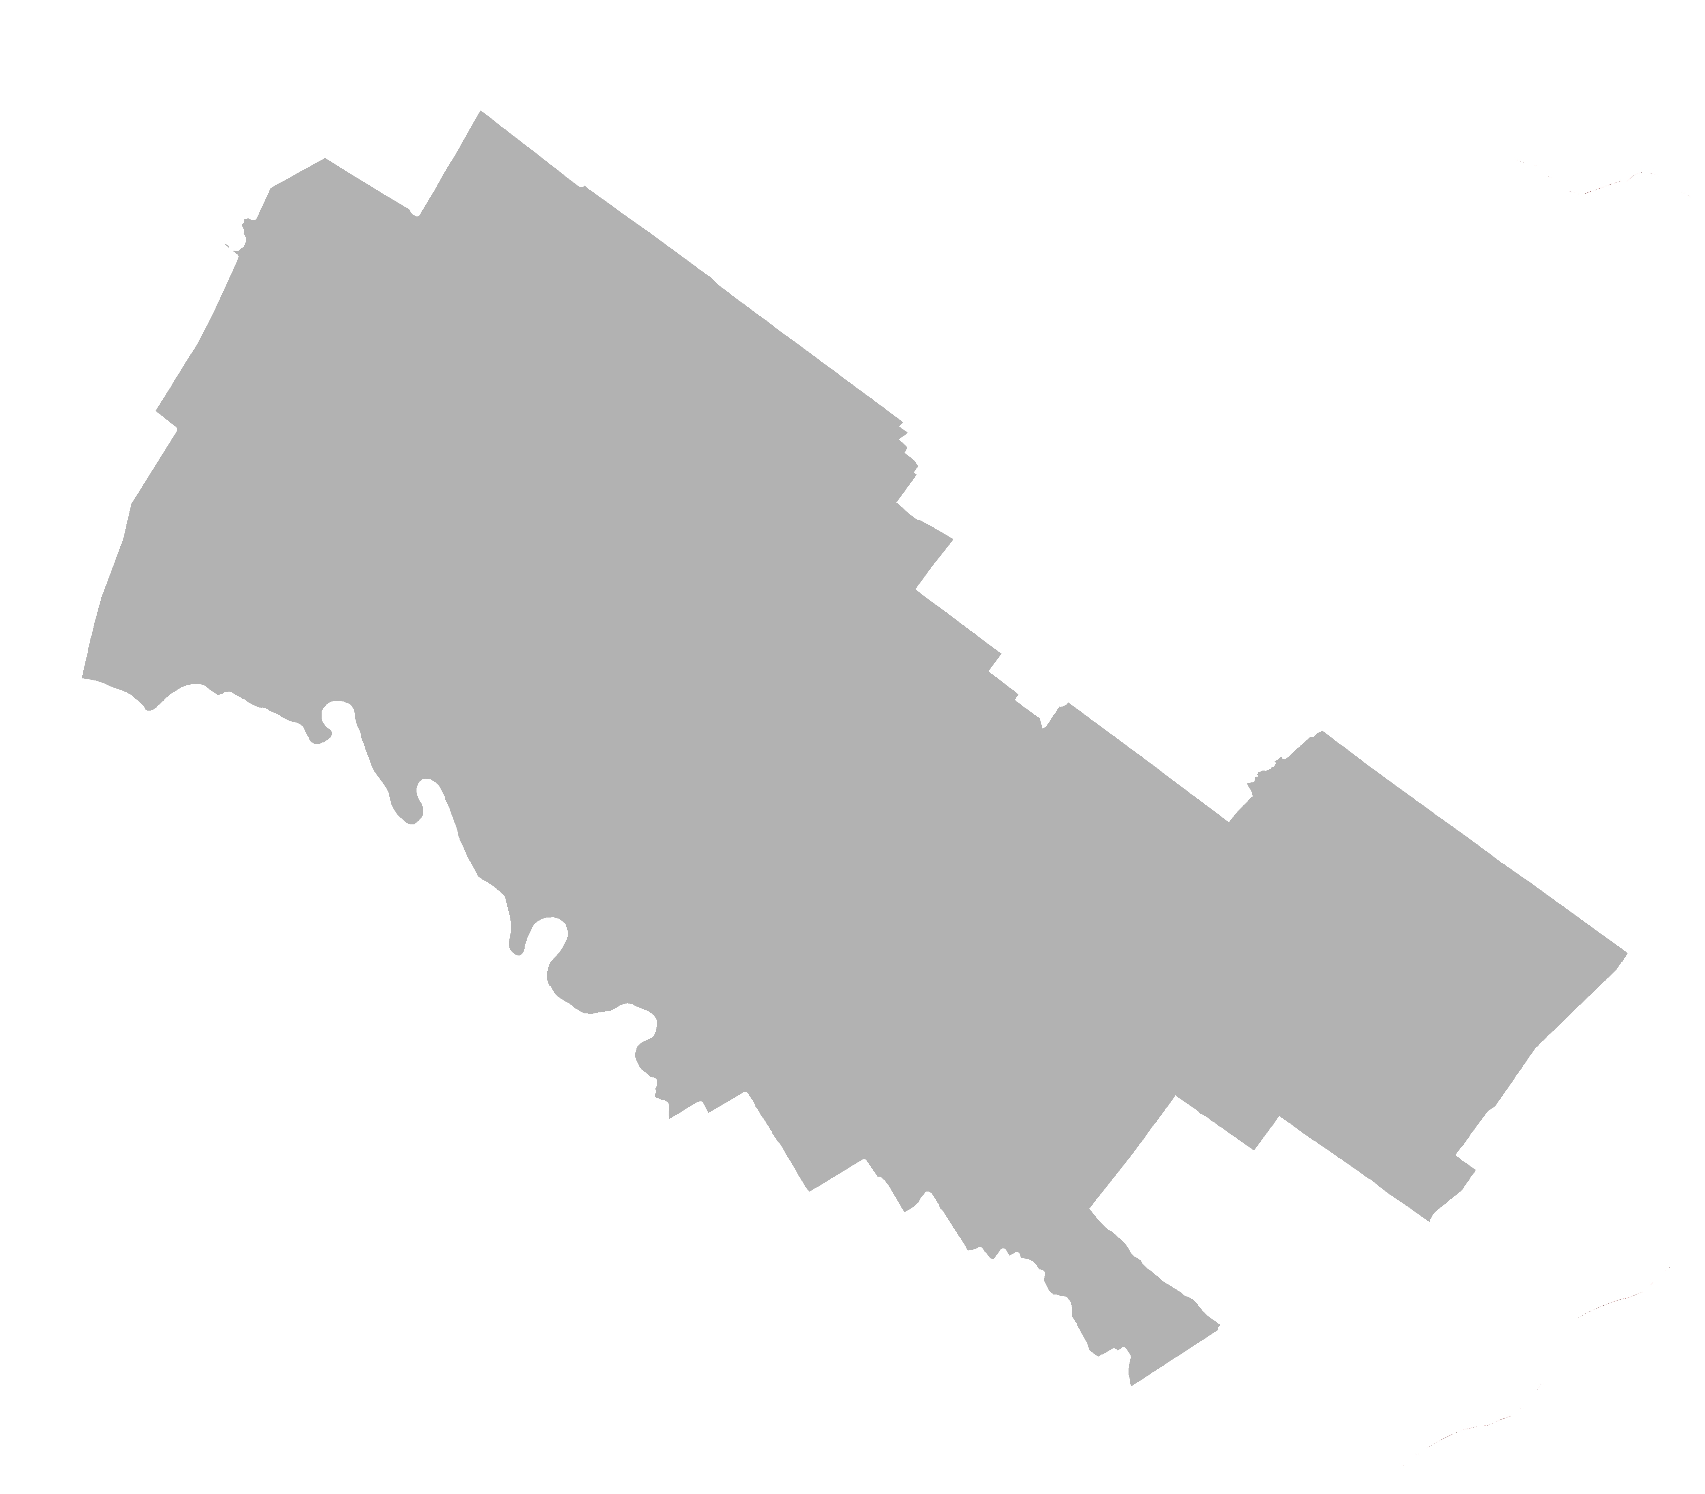
District 4 Strong Democrat
PVI
D+6.79
Counties:
Montgomery (part)
Berks (part)
Reock | Schwartzberg | Polsby-Popper | Population Polygon | Min Convex Poly
0.41 | 1.73 | 0.31 | 0.64 | 0.81

Slide 10
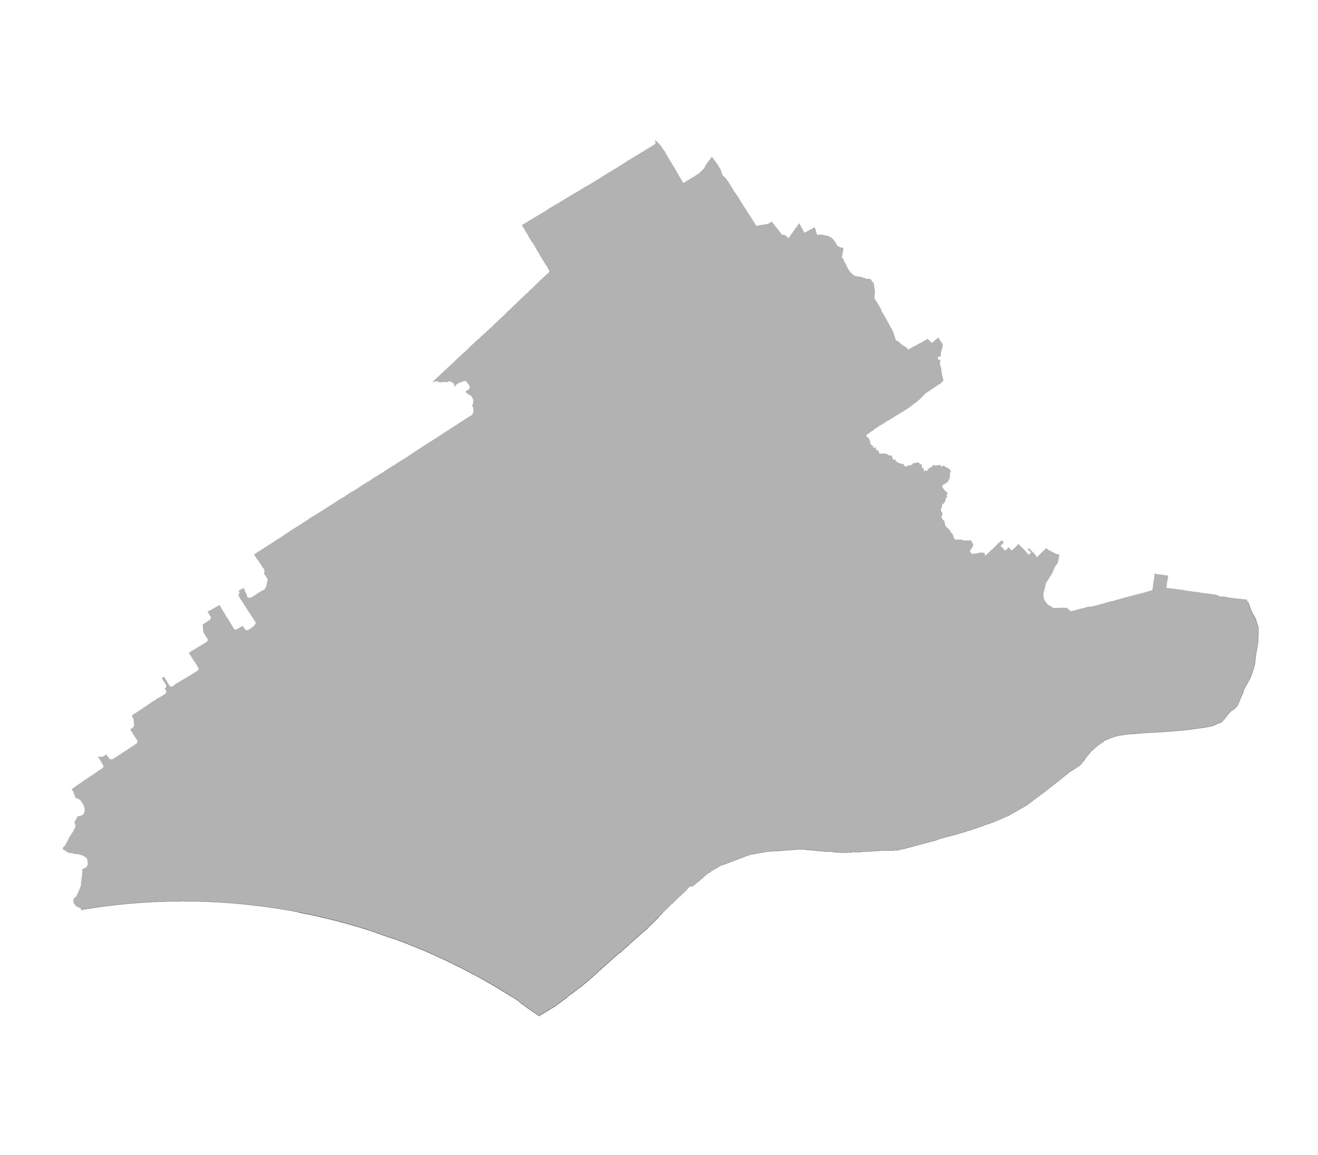
District 5 Strong Democrat
PVI
D+12.72
Counties:
Delaware
Montgomery (part)
Philadelphia (part)
Chester
(one, non-contigious piece)
Reock | Schwartzberg | Polsby-Popper | Population Polygon | Min Convex Poly
0.44 | 1.54 | 0.38 | 0.69 | 0.84

Slide 11
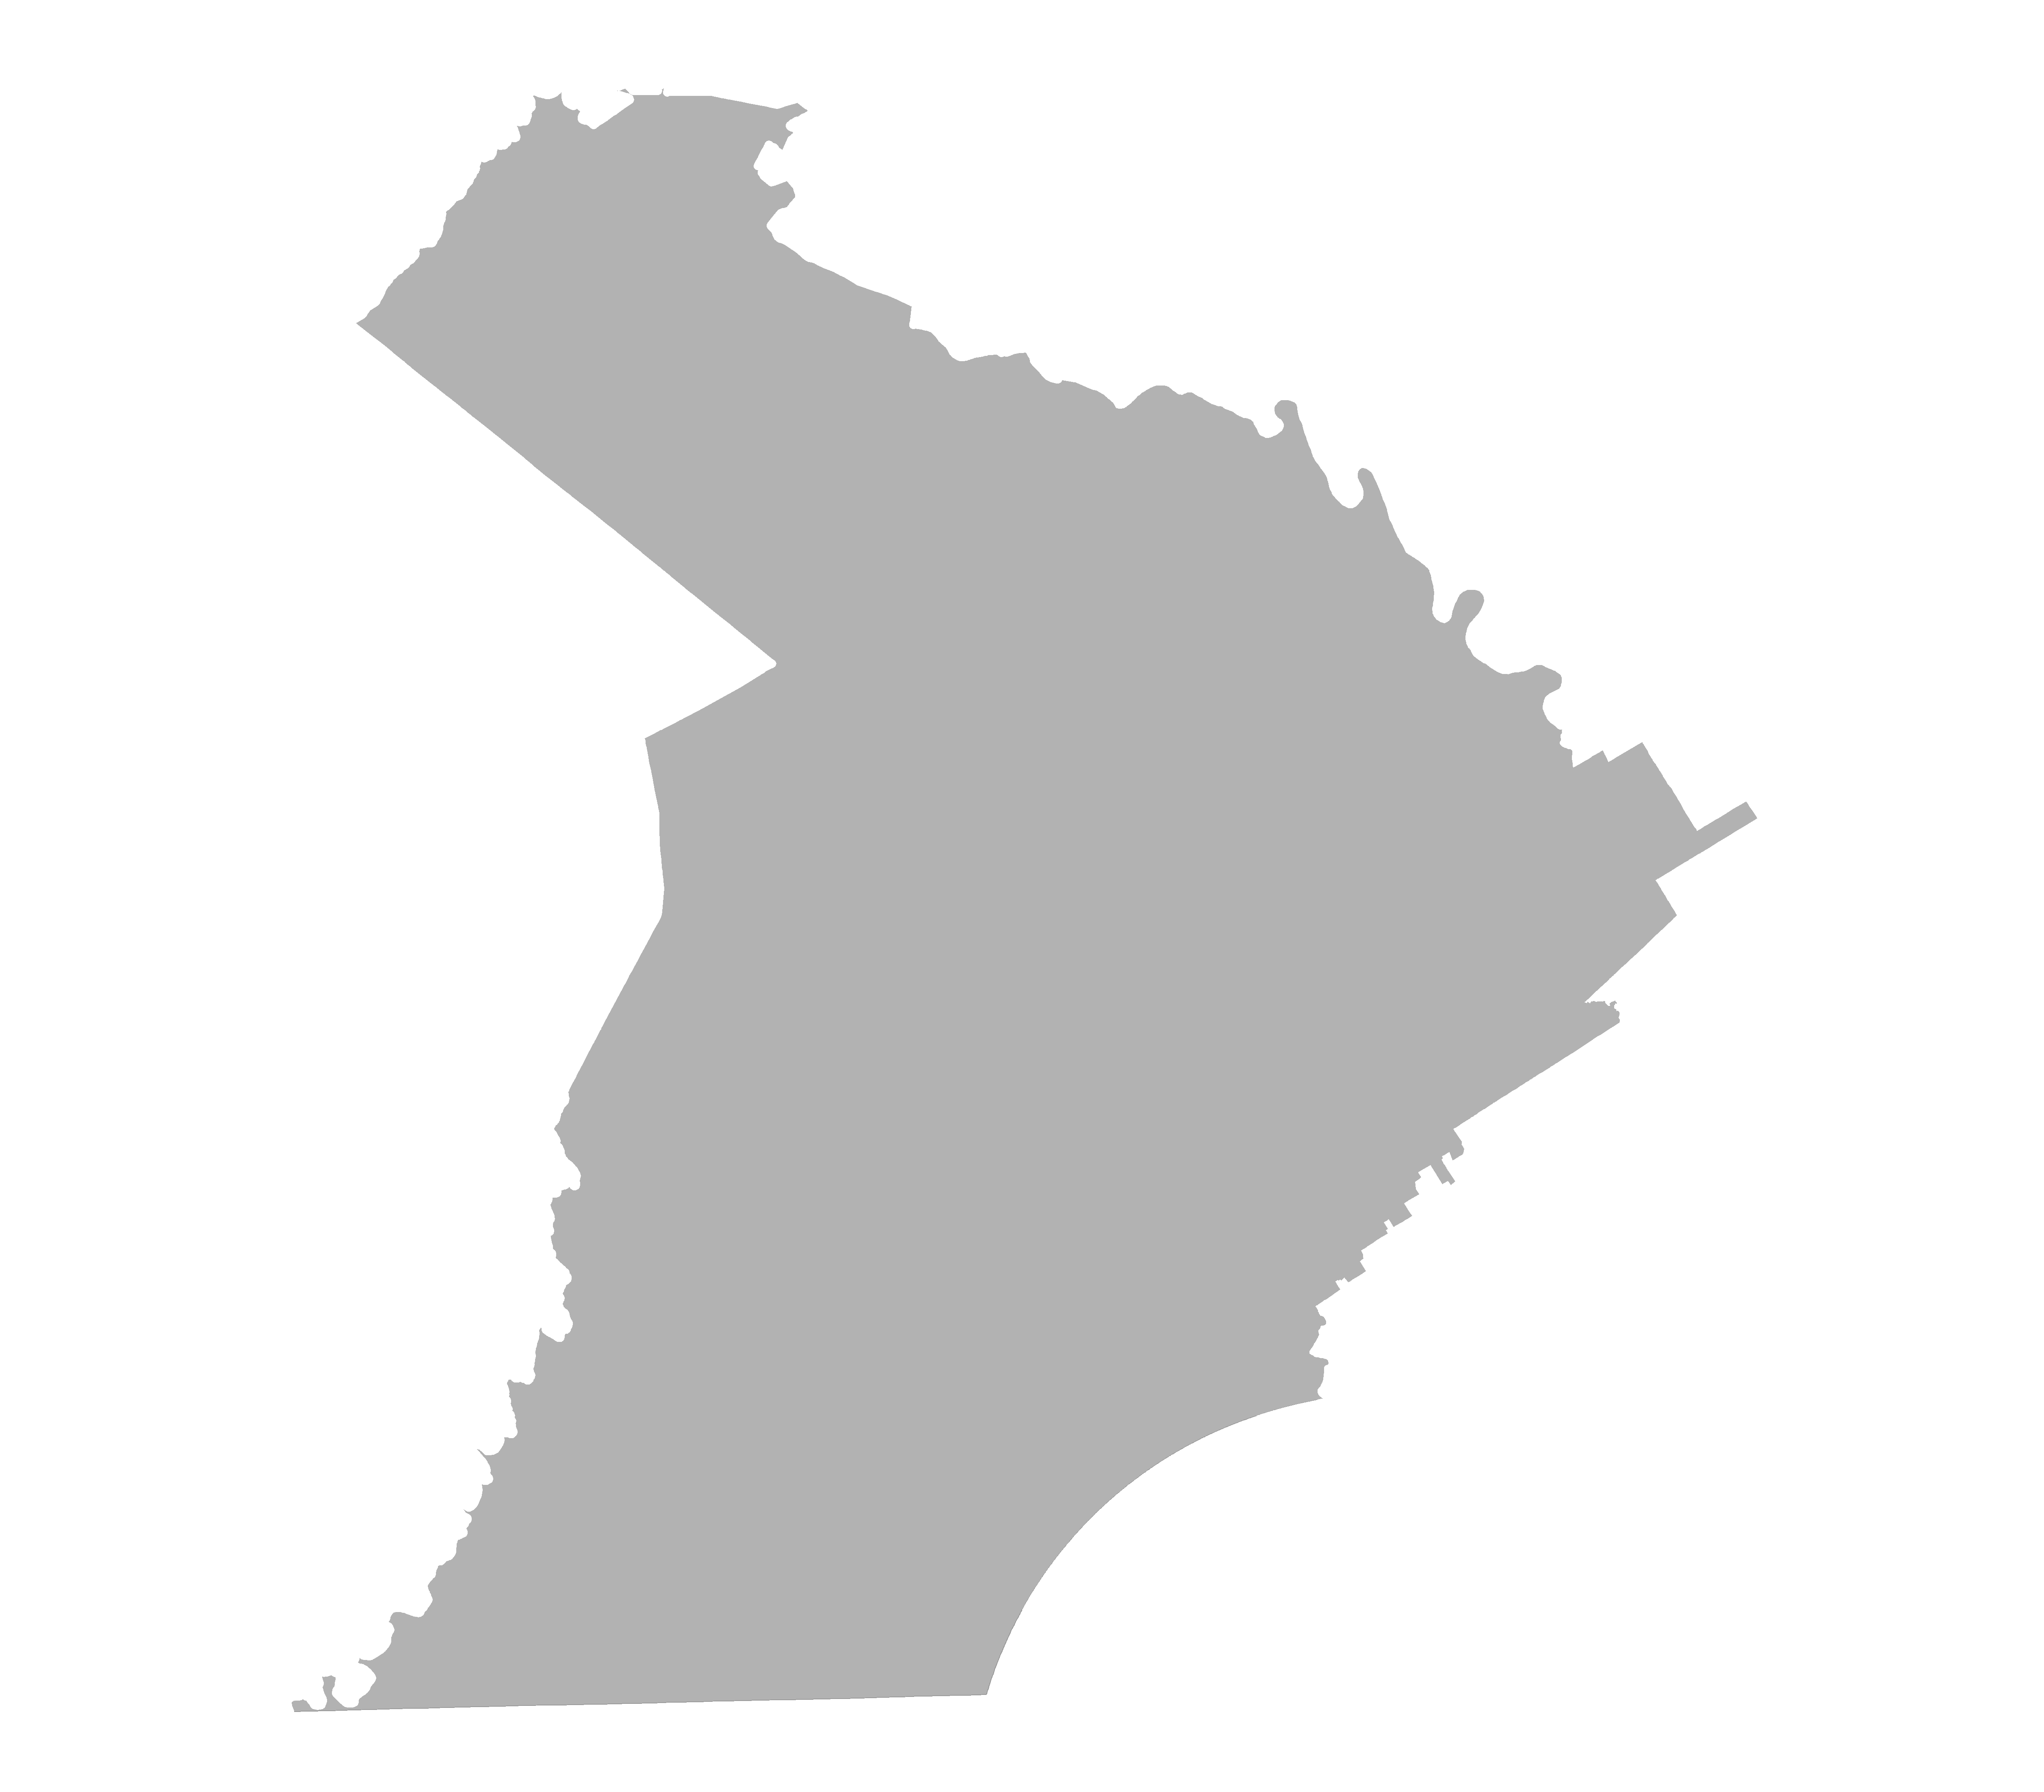
District 6 Lean Democrat
PVI
D+1.71
Counties:
Chester (minus one, non-contigious piece)
Berks (part)
Reock | Schwartzberg | Polsby-Popper | Population Polygon | Min Convex Poly
0.45 | 1.69 | 0.29 | 0.82 | 0.72

Slide 12
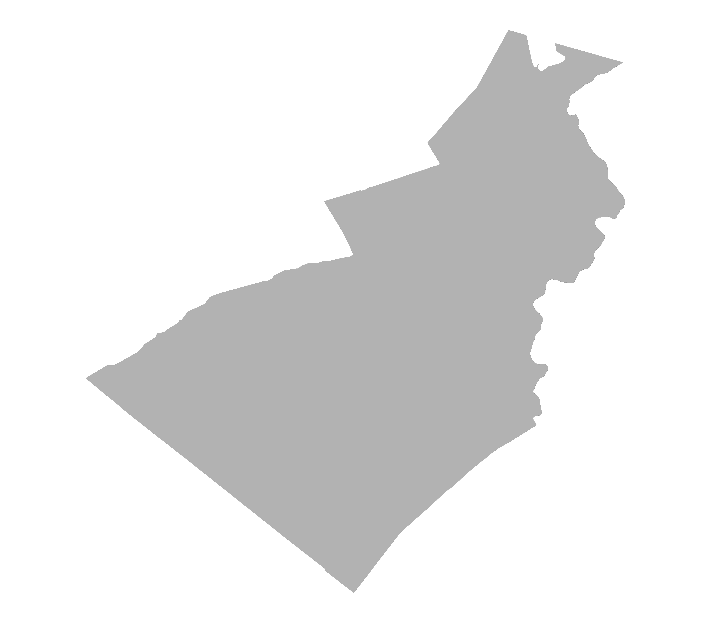
District 7 Lean Democrat
PVI
D+0.51
Counties:
Lehigh
Northampton
Monroe (part)
Reock | Schwartzberg | Polsby-Popper | Population Polygon | Min Convex Poly
0.41 | 1.50 | 0.42 | 0.95 | 0.83

Slide 13
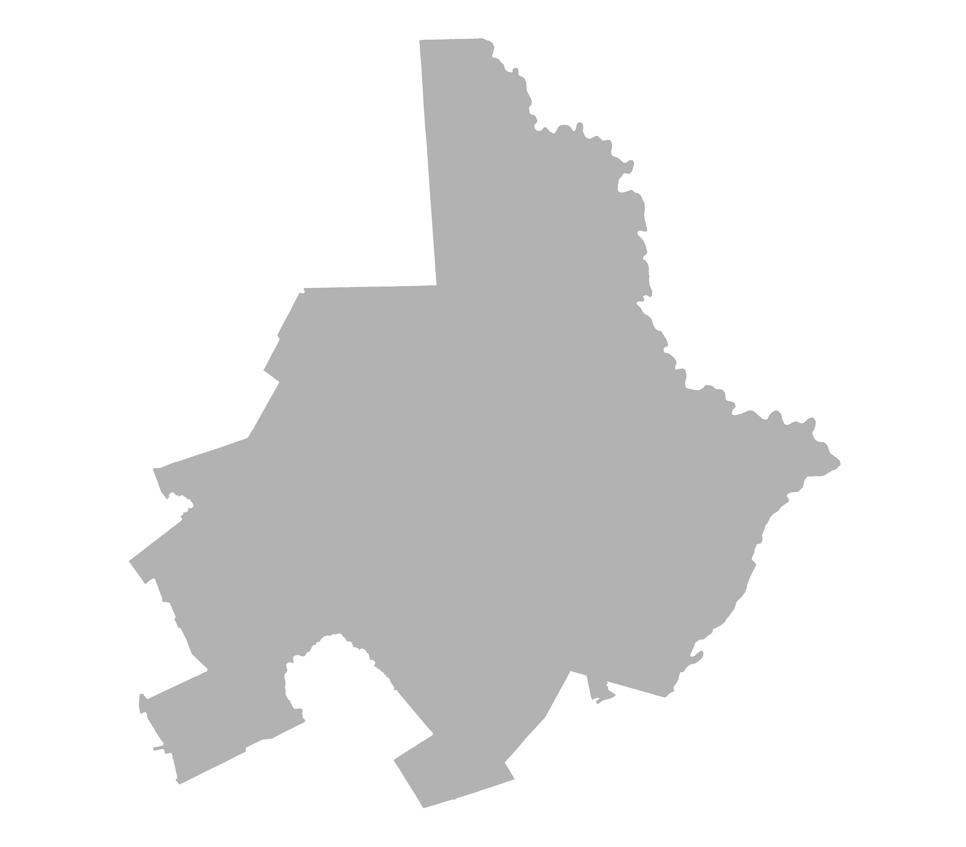
District 8 Lean Republican
PVI
R+0.95
Counties:
Wayne
Pike
Lackawanna
Monroe (part)
Luzerne (part)
Reock | Schwartzberg | Polsby-Popper | Population Polygon | Min Convex Poly
0.49 | 1.73 | 0.28 | 0.88 | 0.75

Slide 14
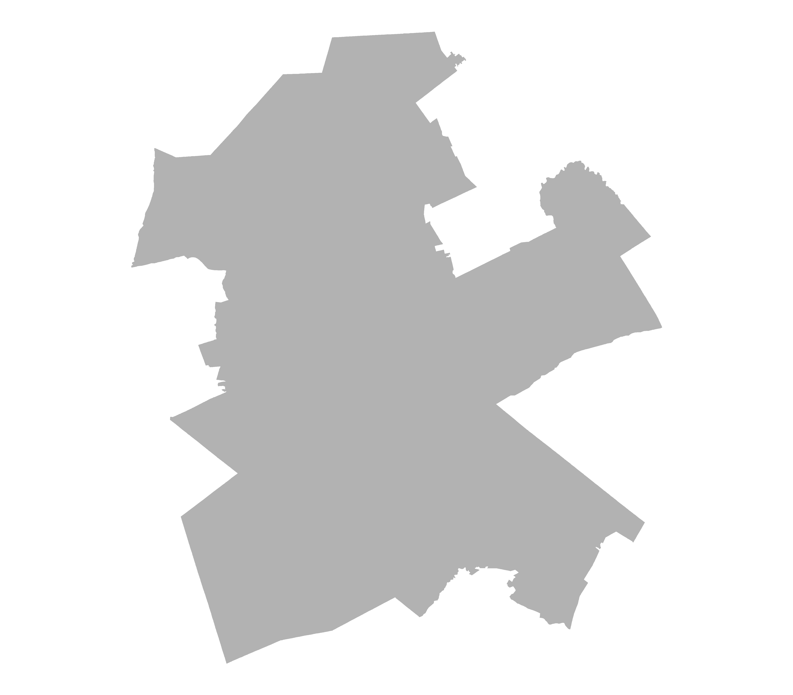
District 9 Strong Republican
PVI
R+14.47
Counties:
Schuylkill
Carbon
Columbia
Montour
Lebanon
Berks (part)
Luzerne (part)
Northumberland (part)
Reock | Schwartzberg | Polsby-Popper | Population Polygon | Min Convex Poly
0.55 | 1.94 | 0.25 | 0.53 | 0.74

Slide 15
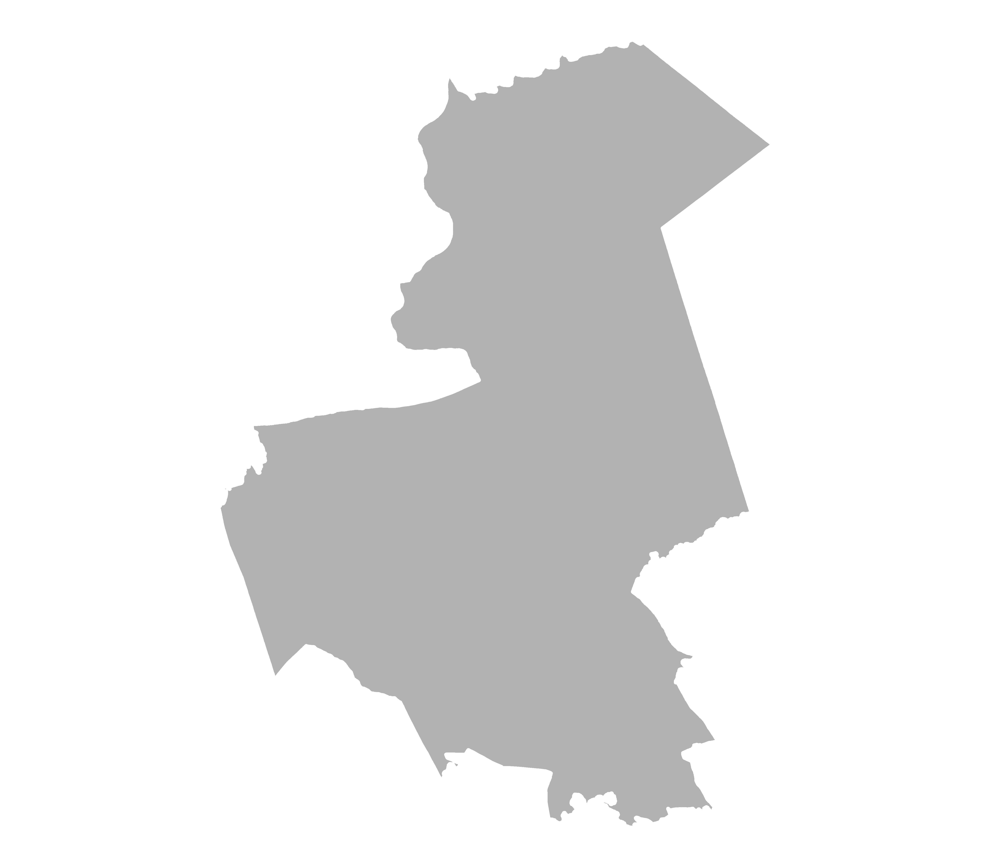
District 10 Lean Republican
PVI
R+5.55
Counties:
Dauphin
York (part)
Cumberland (part)
Reock | Schwartzberg | Polsby-Popper | Population Polygon | Min Convex Poly
0.49 | 1.72 | 0.29 | 0.88 | 0.76

Slide 16
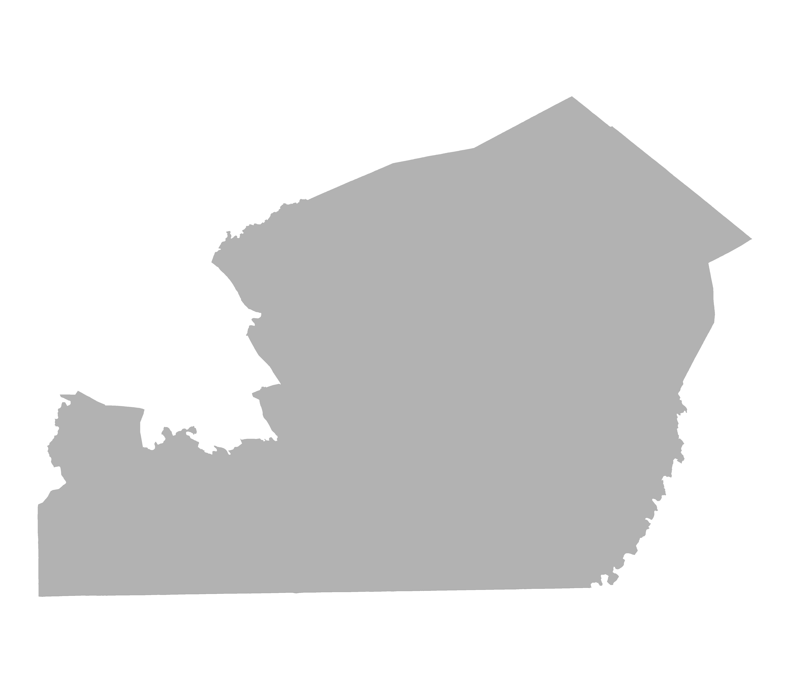
District 11 Strong Republican
PVI
R+14.05
Counties:
Lancaster
York (part)
Reock | Schwartzberg | Polsby-Popper | Population Polygon | Min Convex Poly
0.45 | 1.51 | 0.37 | 0.78 | 0.88

Slide 17
District 12 Strong Republican
PVI
R+17.27
Counties:
Potter
Tioga
Bradford
Susquehanna
Clinton
Lycoming
Sullivan
Wyoming
Union
Snyder
Juniata
Mifflin
Perry
Northumberland (part)
Centre (part)
Reock | Schwartzberg | Polsby-Popper | Population Polygon | Min Convex Poly
0.43 | 1.83 | 0.28 | 0.64 | 0.78

Slide 18
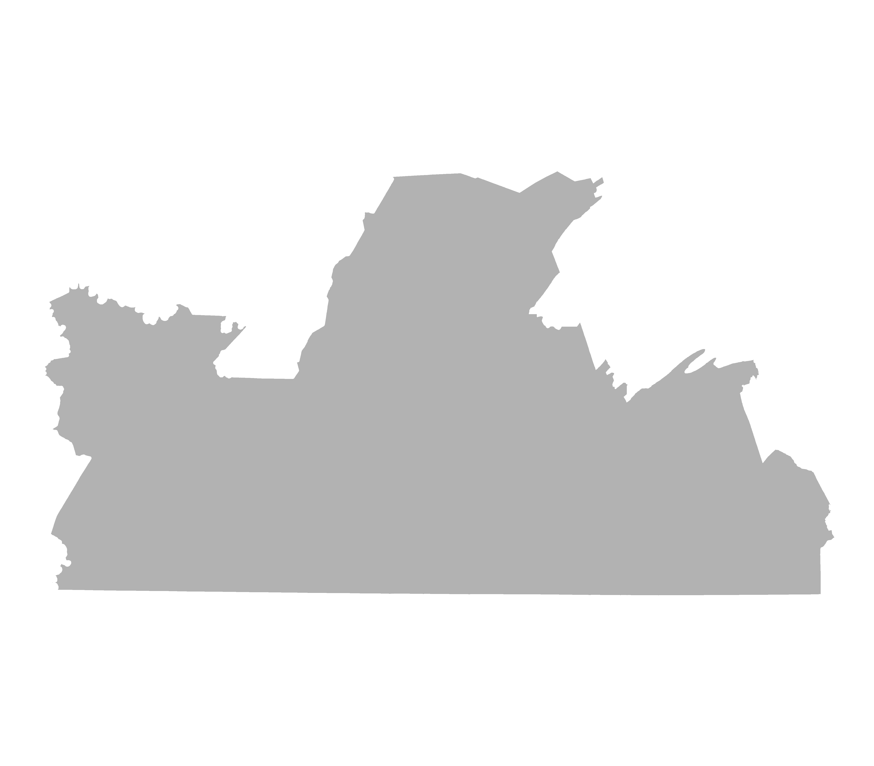
District 13 Strong Republican
PVI
R+22.14
Counties:
Somerset
Blair
Huntingdon
Bedford
Fulton
Franklin
Adams
Cumberland (part)
Cambria (part)
Westmoreland (part)
Reock | Schwartzberg | Polsby-Popper | Population Polygon | Min Convex Poly
0.40 | 1.81 | 0.26 | 0.75 | 0.79

Slide 19
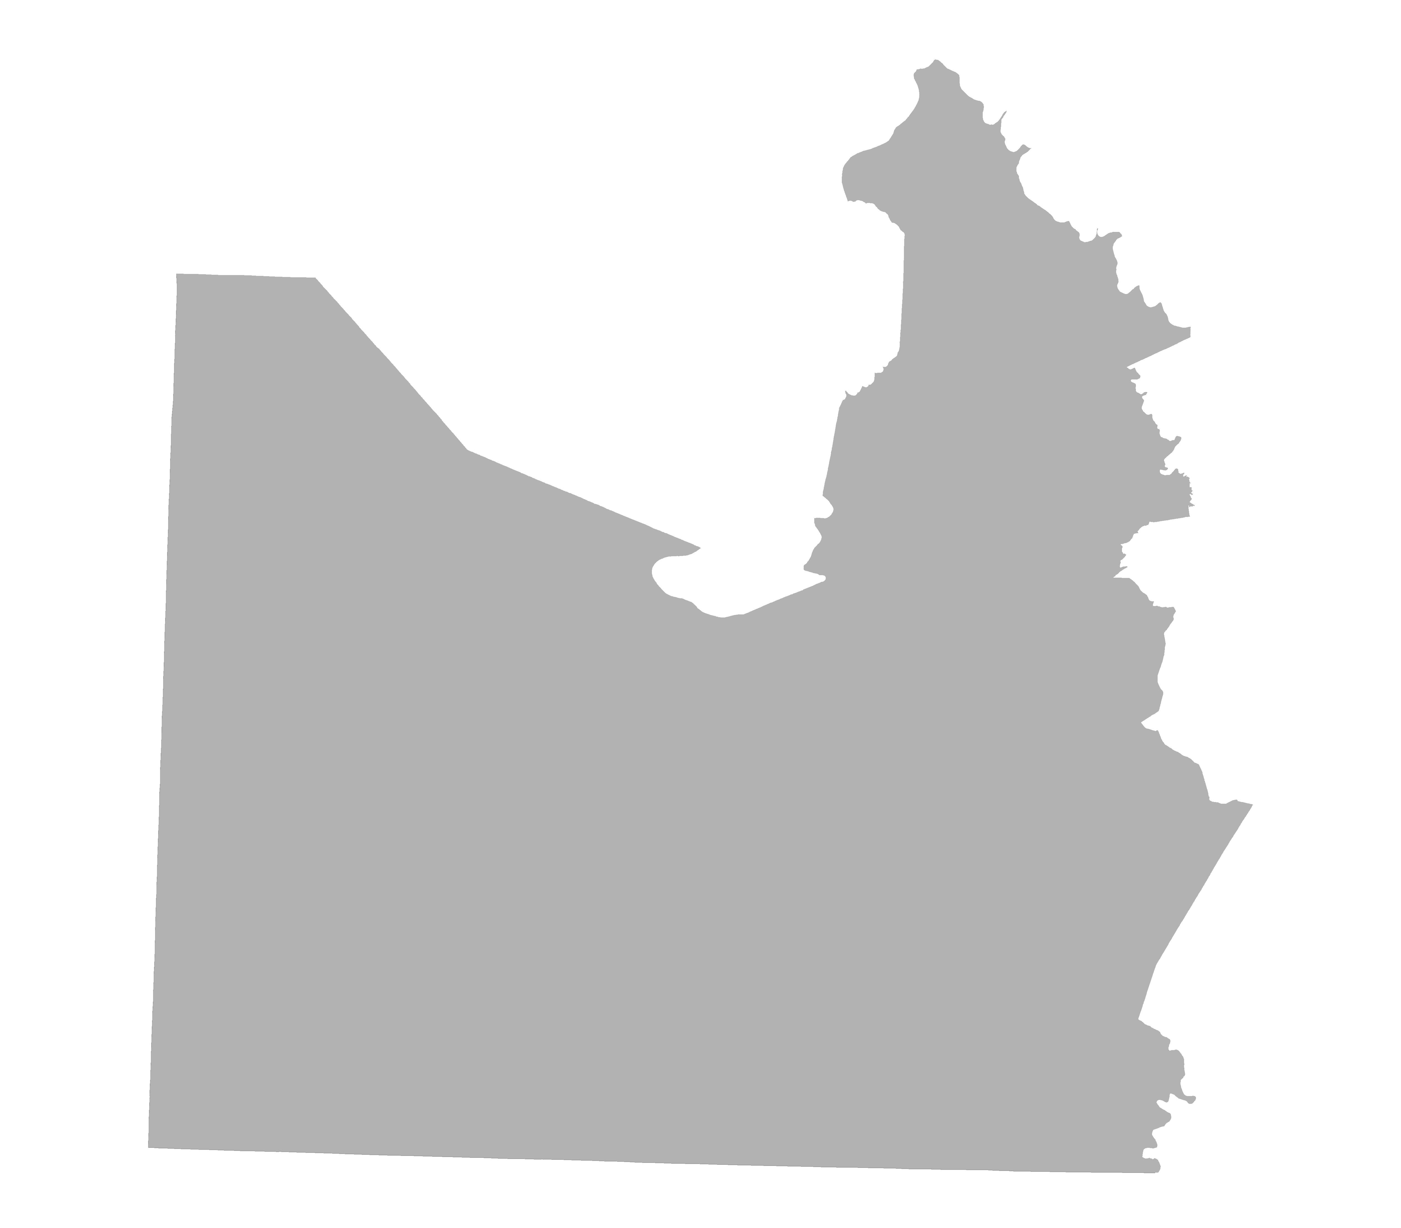
District 14 Strong Republican
PVI
R+13.51
Counties:
Washington
Greene
Fayette
Westmoreland (part)
Reock | Schwartzberg | Polsby-Popper | Population Polygon | Min Convex Poly
0.54 | 1.63 | 0.34 | 0.37 | 0.77

Slide 20
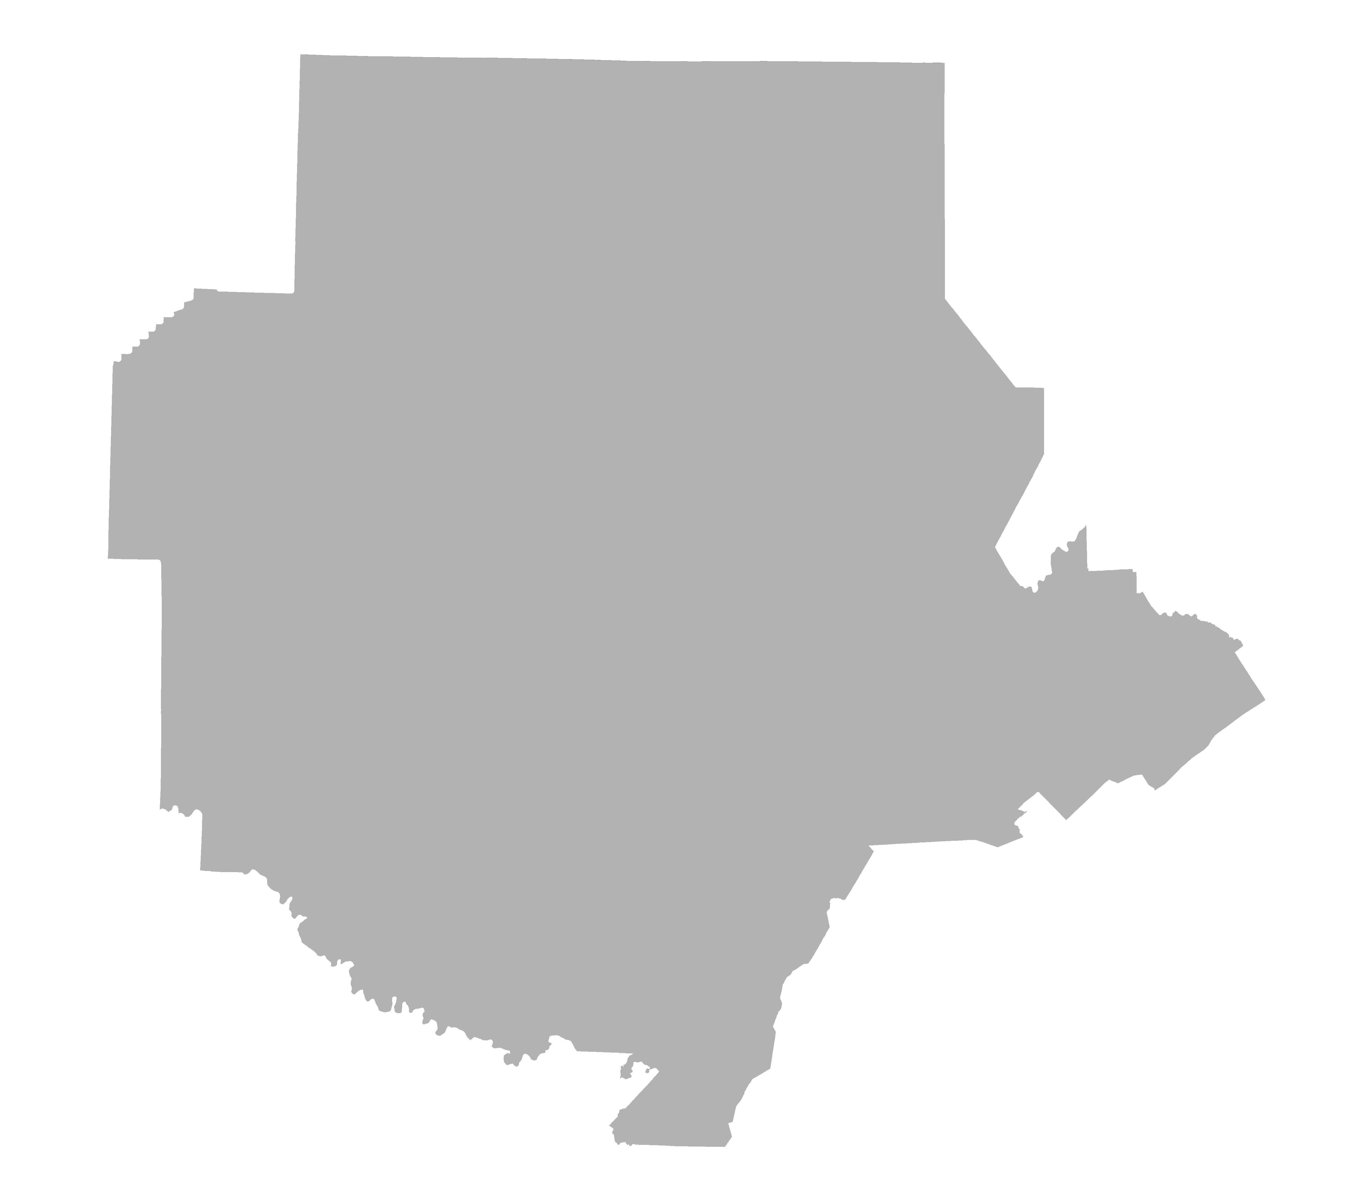
District 15 Strong Republican
PVI
R+19.58
Counties:
Warren
McKean
Venango
Forest
Elk
Cameron
Clearfield
Jefferson
Indiana
Armstrong
Butler (part)
Centre (part)
Reock | Schwartzberg | Polsby-Popper | Population Polygon | Min Convex Poly
0.67 | 1.46 | 0.42 | 0.69 | 0.86

Slide 21
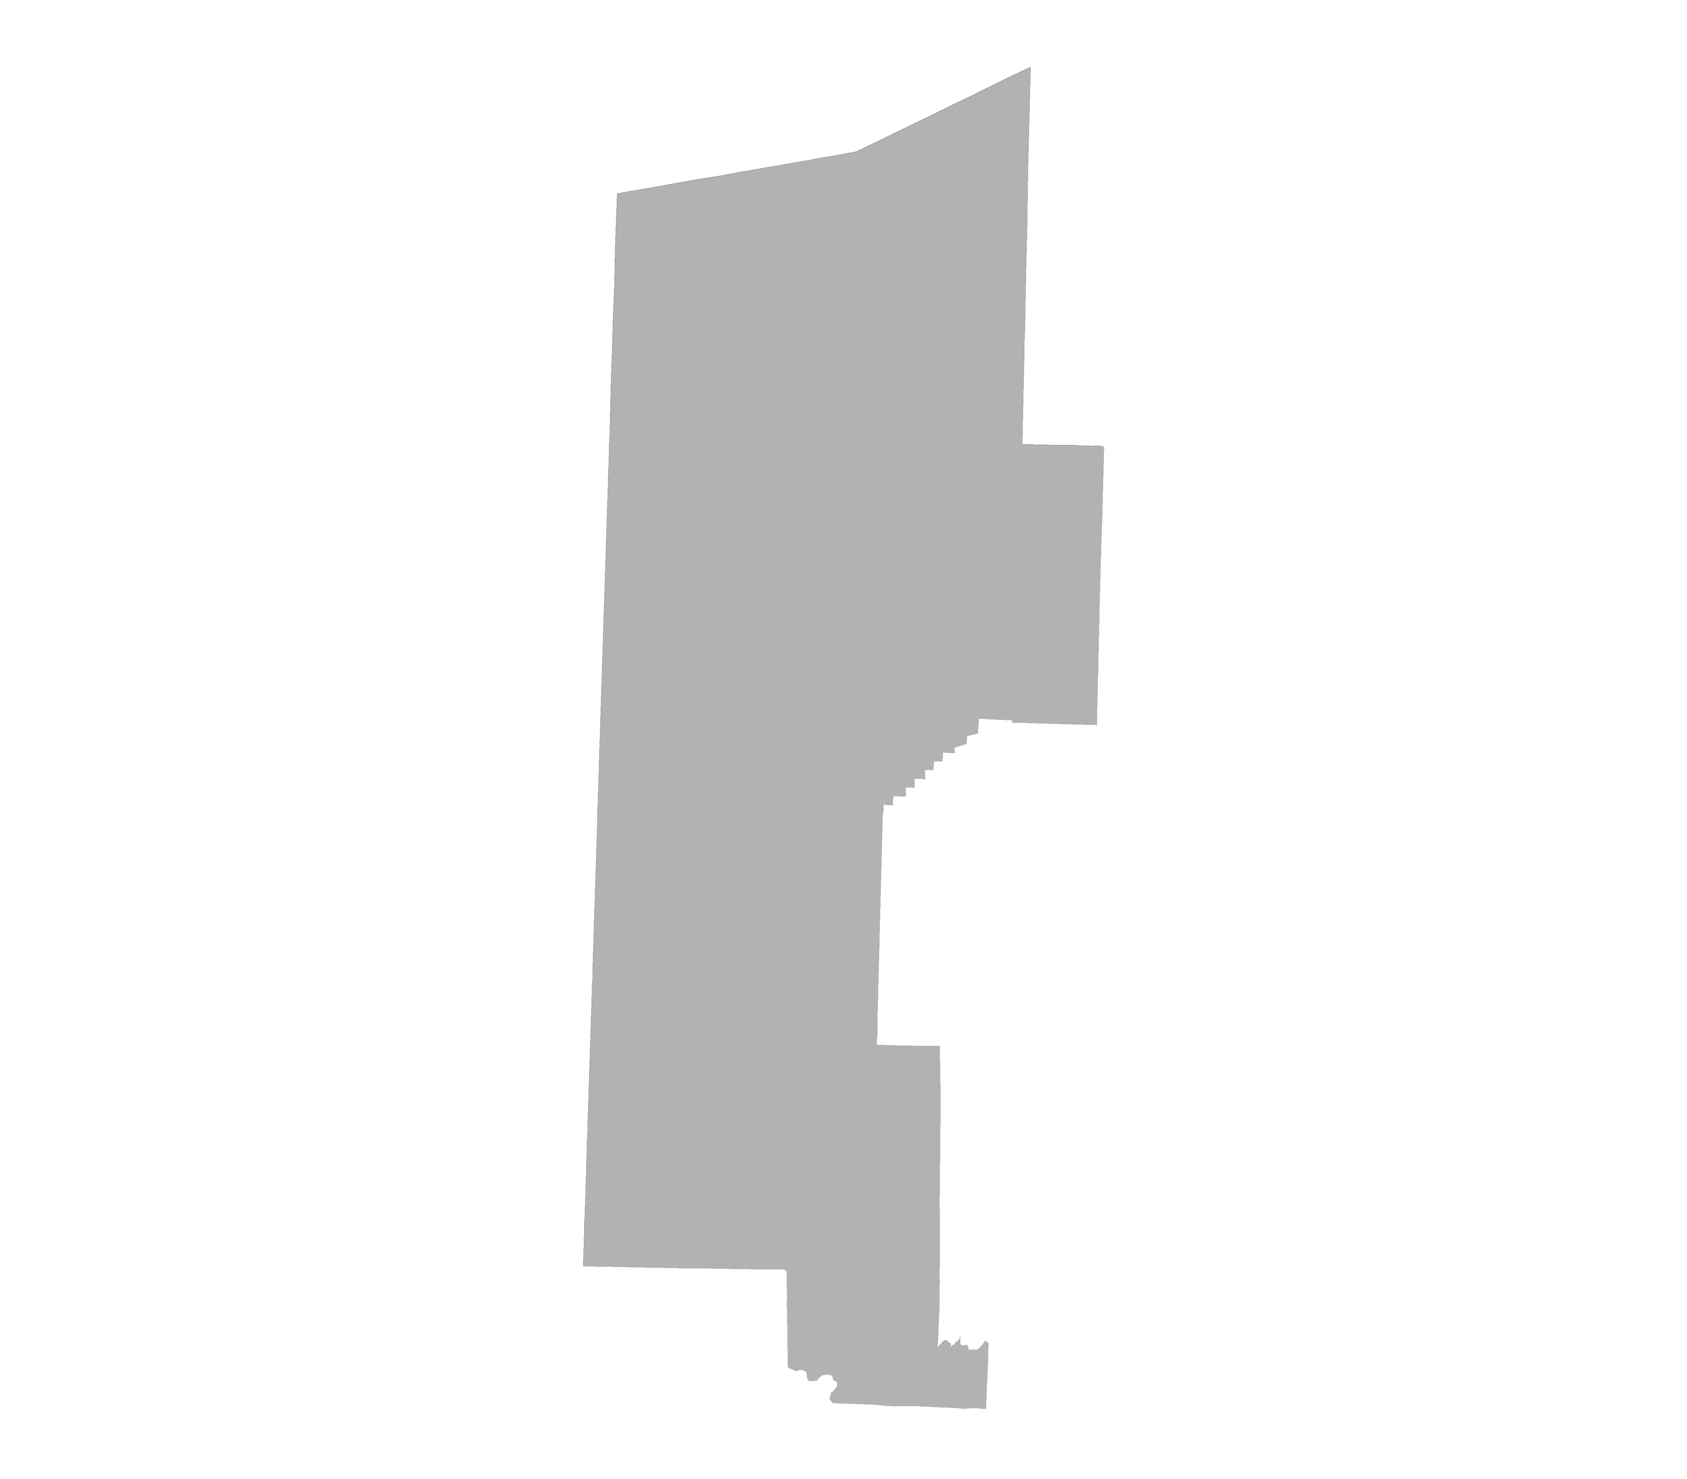
District 16 Strong Republican
PVI
R+7.98
Counties:
Erie
Crawford
Mercer
Lawrence
Butler (part)
Reock | Schwartzberg | Polsby-Popper | Population Polygon | Min Convex Poly
0.32 | 1.43 | 0.38 | 0.87 | 0.80

Slide 22
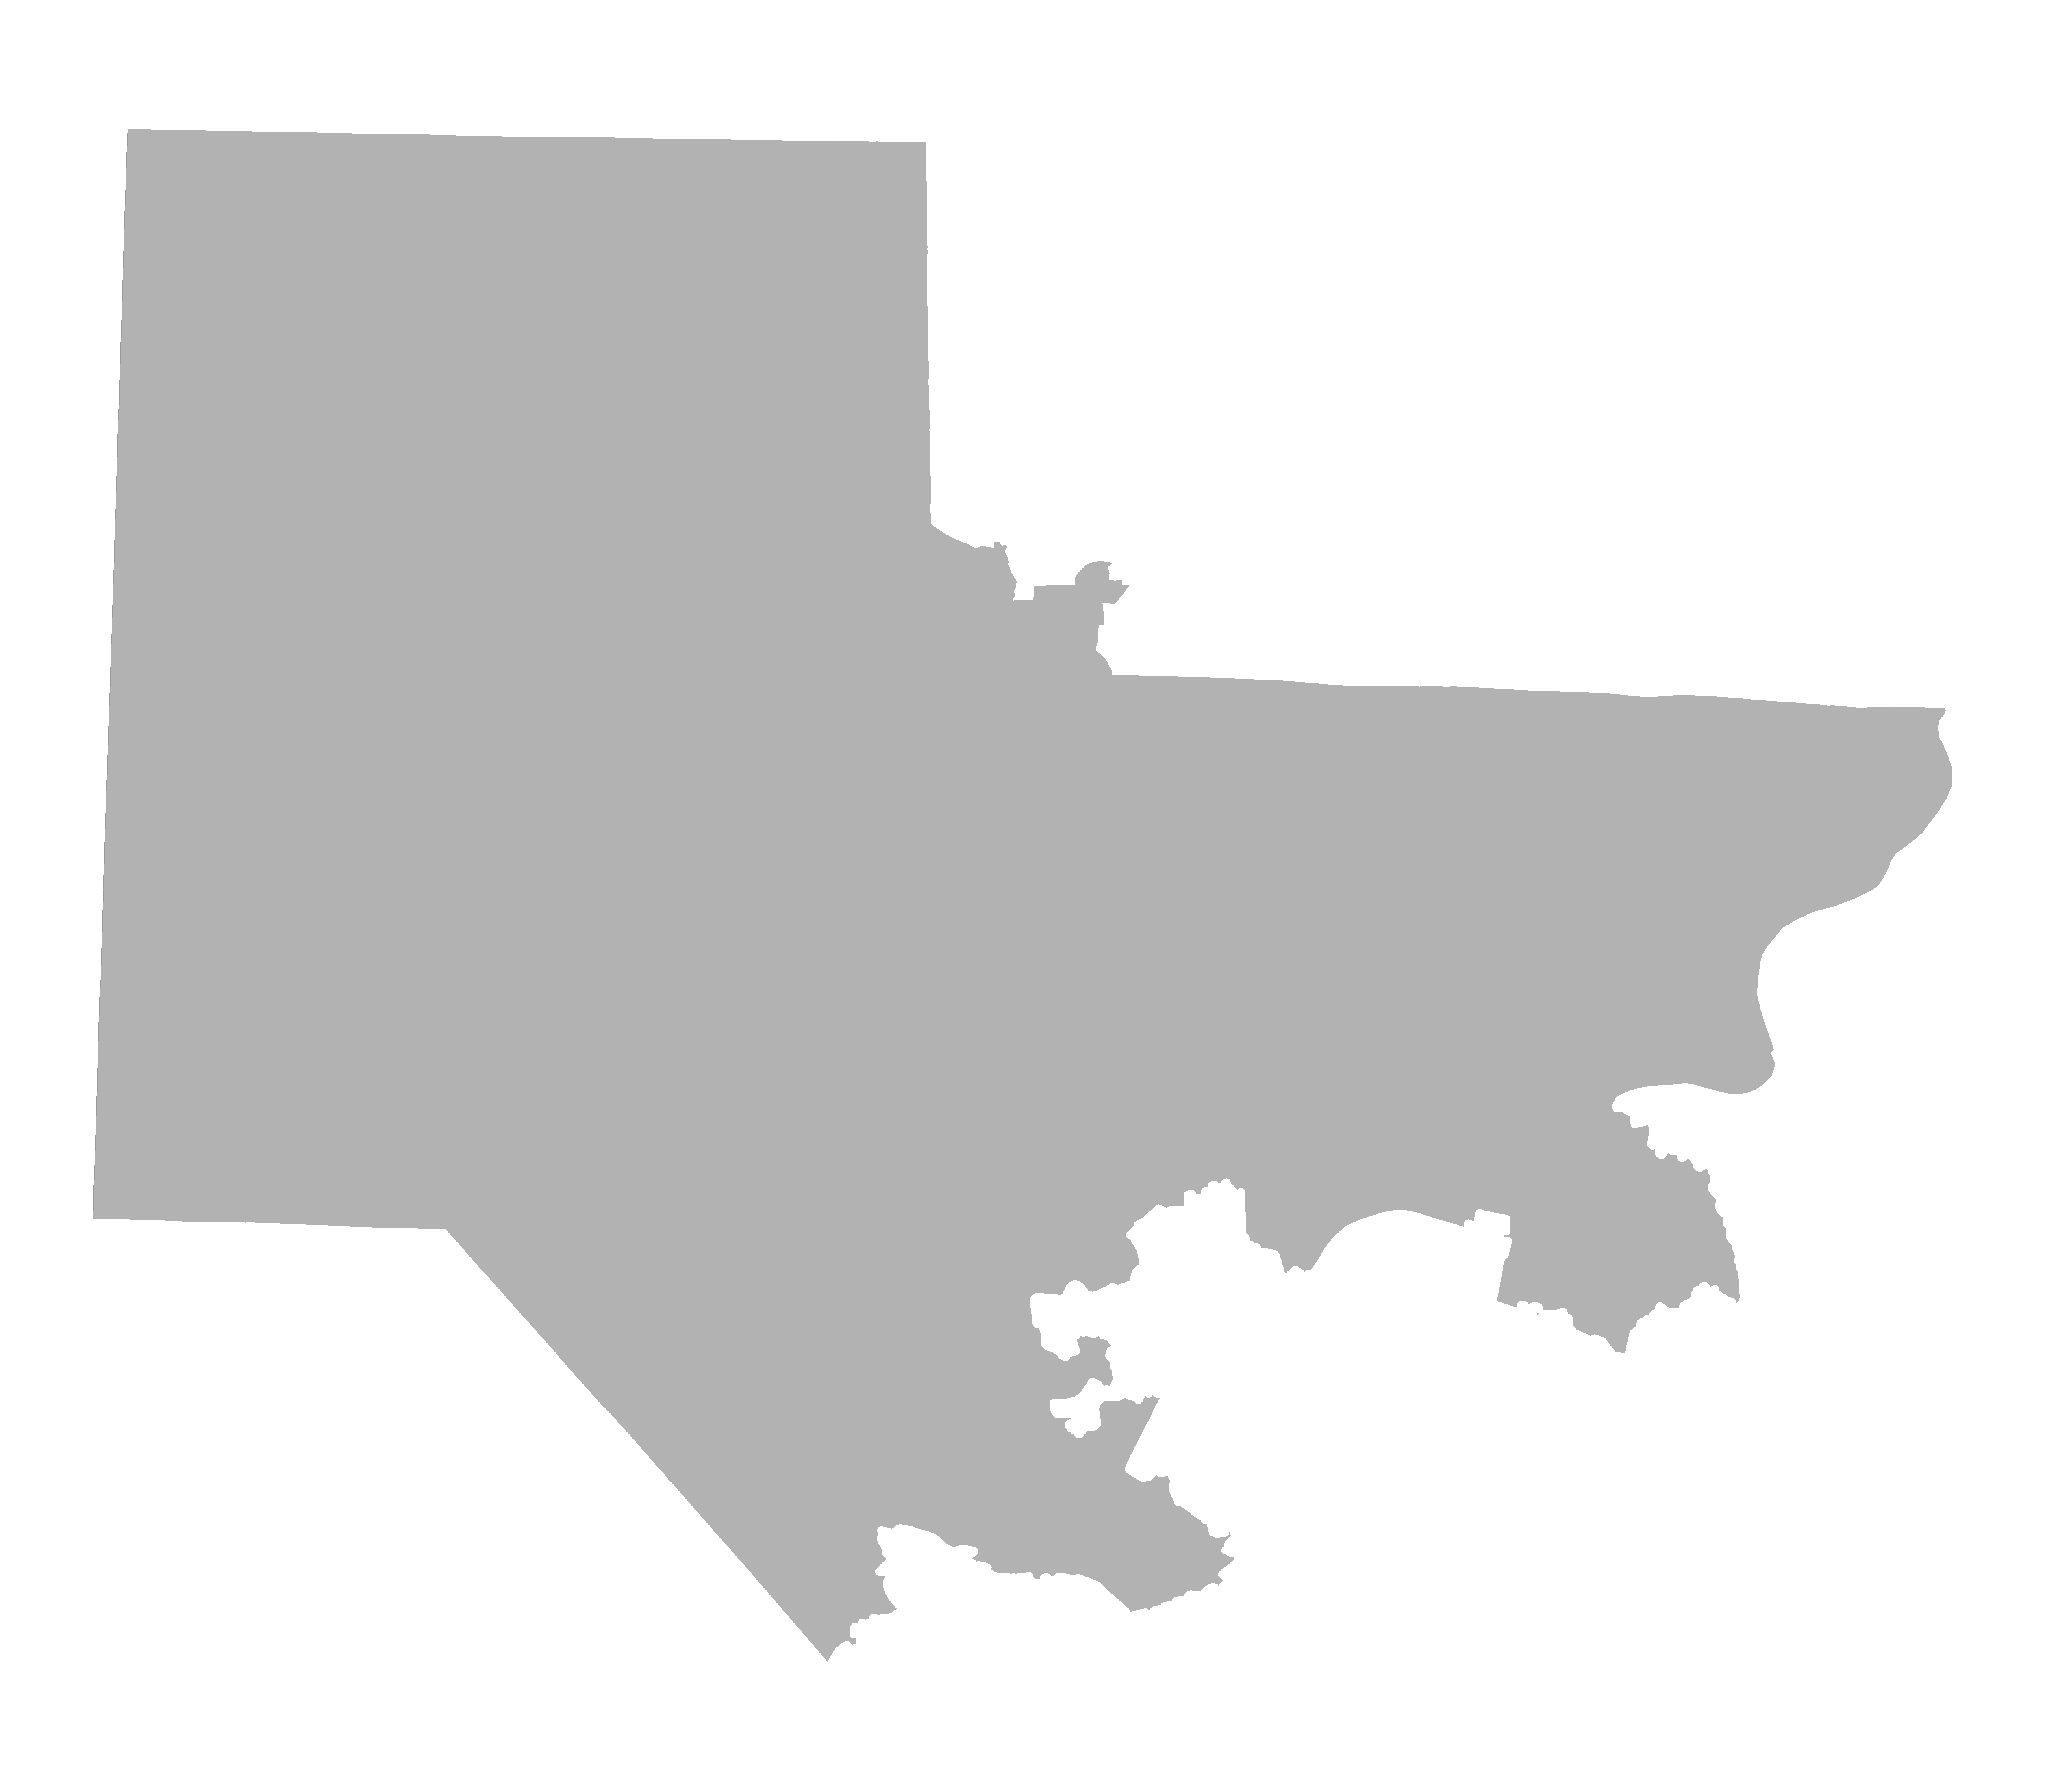
District 17 Lean Republican
PVI
R+3.22
Counties:
Beaver
Allegheny (part)
Butler (part)
Reock | Schwartzberg | Polsby-Popper | Population Polygon | Min Convex Poly
0.51 | 1.80 | 0.28 | 0.60 | 0.76

Slide 23
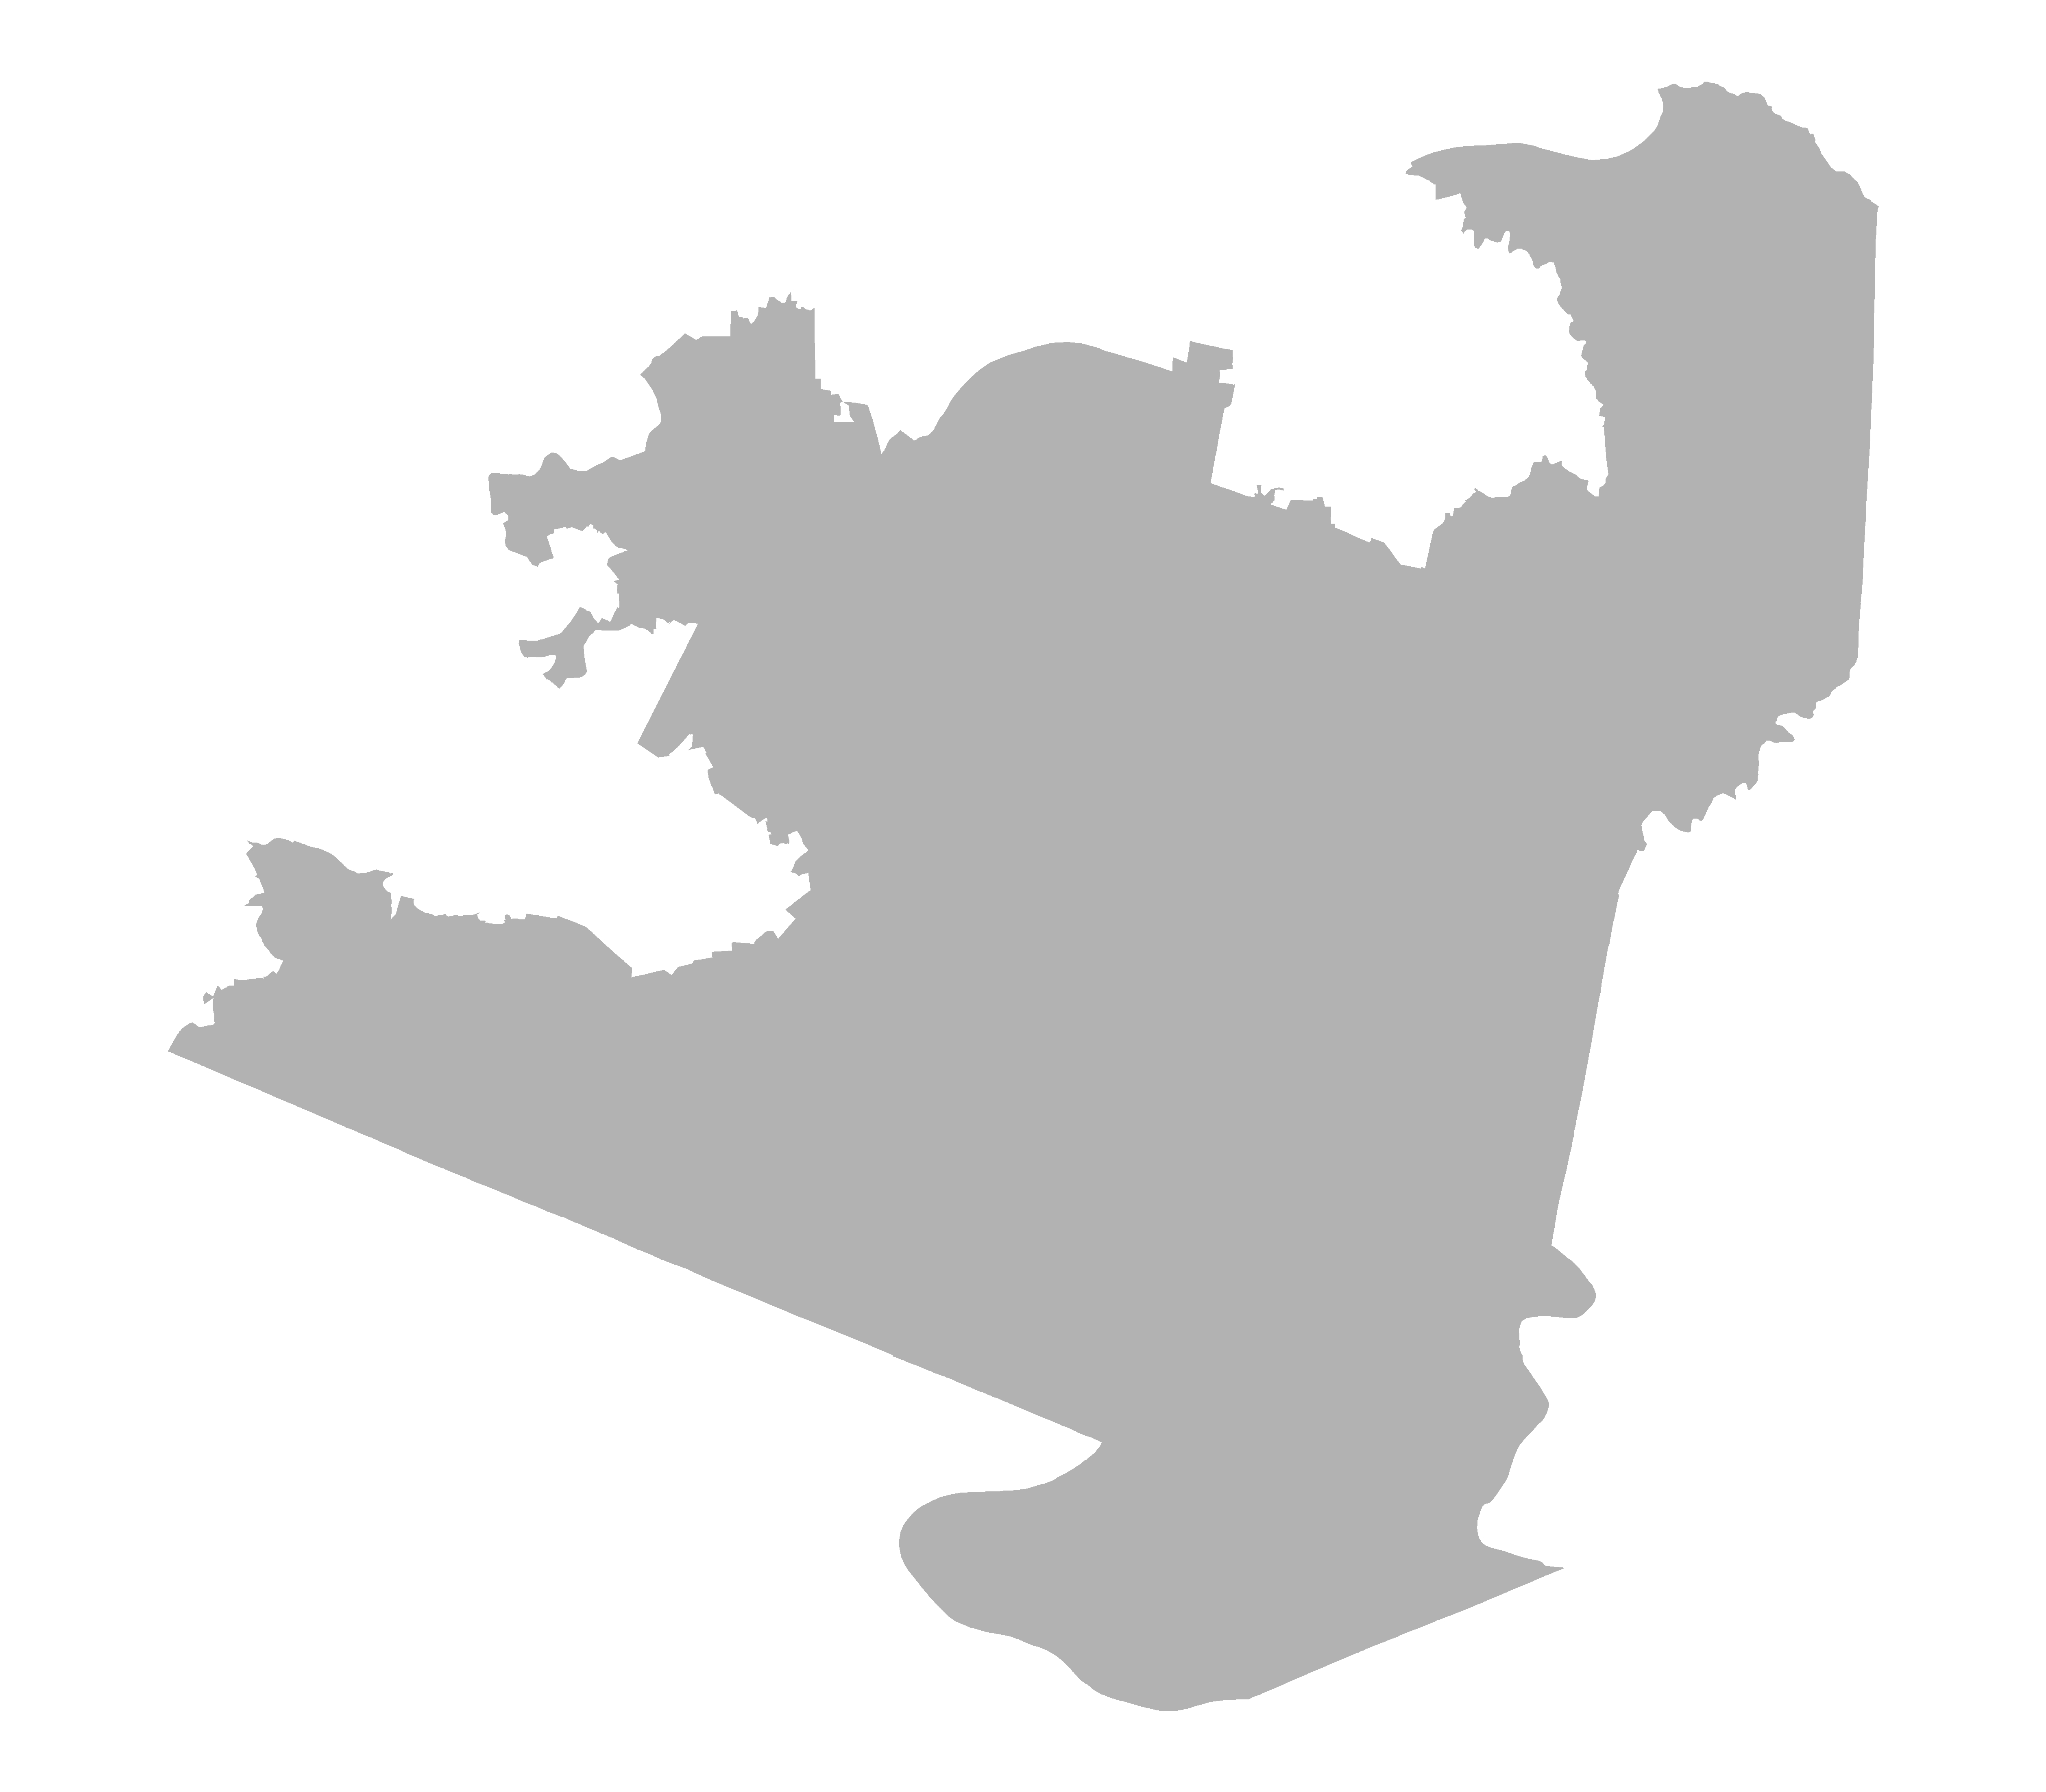
District 18 Strong Democrat
PVI
D+12.67
Counties:
Allegheny
Reock | Schwartzberg | Polsby-Popper | Population Polygon | Min Convex Poly
0.46 | 2.21 | 0.18 | 0.75 | 0.72

